Slide 1

Senior Swordplay

Slide 2
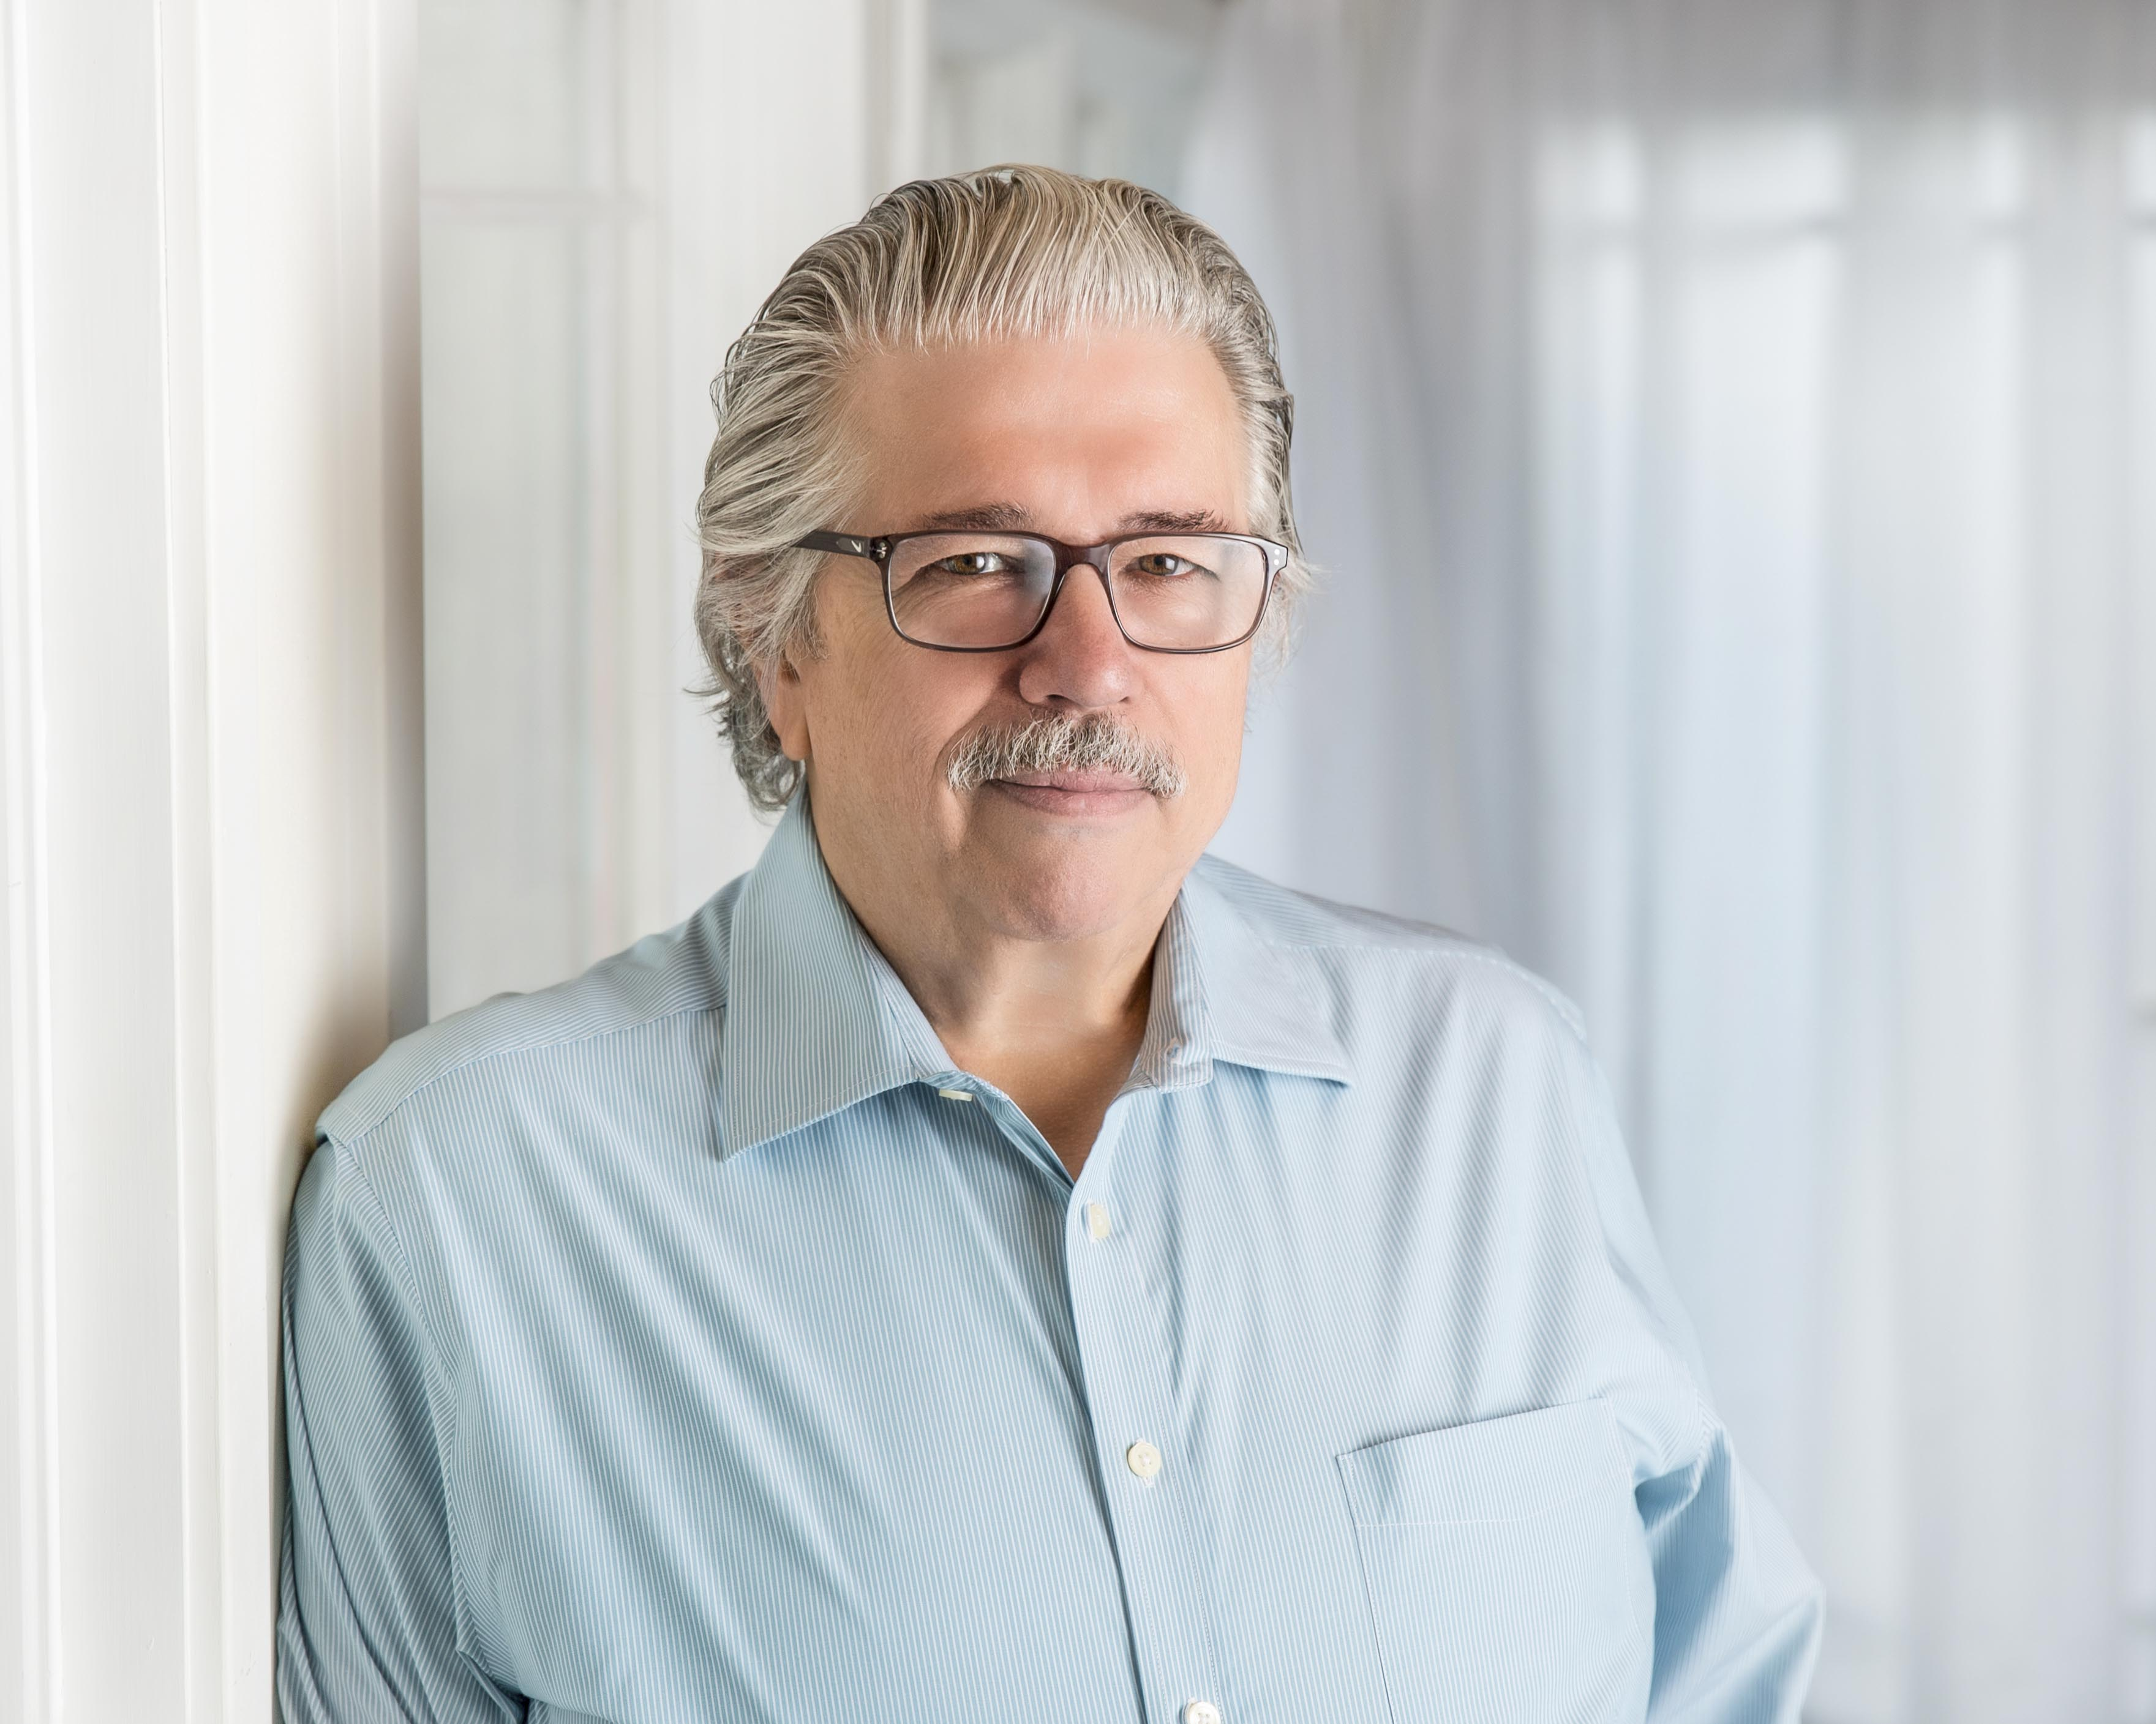



SYNOPSIS
Kim E. Ruyle The Dramatists Guild
Wisconsin-based The Playwrights’ Center
Playwright AACT
Kim had a long and successful career as a human resource executive and leadership development consultant. Kim’s academic credentials include three master’s degrees and a PhD.
Awards:
Sliding into Seniorhood – Grand Winner of 2020/2021 Original Playwrights Full-Length Competition (Shawnee Playhouse/Pennsylvania Council of the Arts)
Sky Club Compatibility – Winner of 2019 Brevard One-Act Play Writing Competition
Kalispell – Winner of 2018 Brevard Full-Length Play Writing Competition

Slide 3
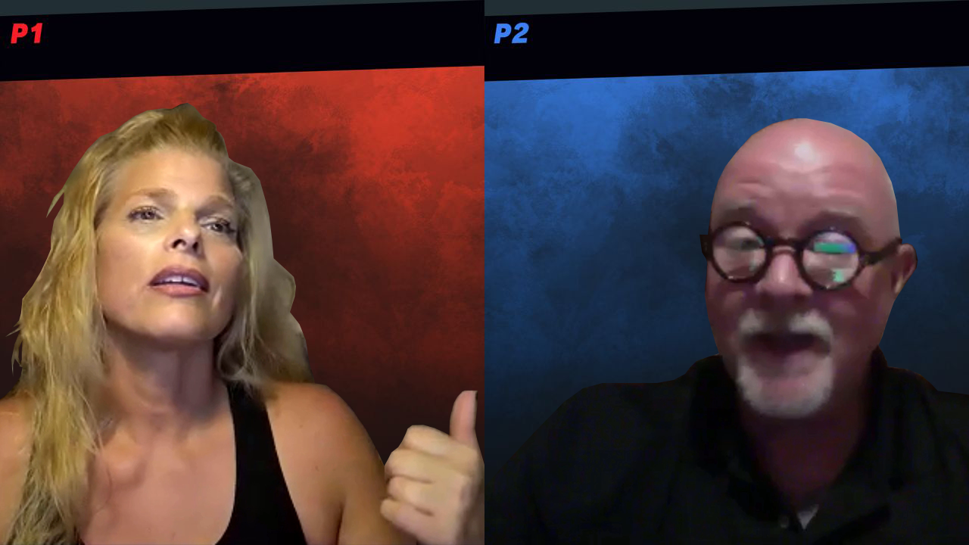
CHARACTER BREAKDOWN
Female
A PhD psychologist
Any ethnicity
50s
Male
A welder
Any ethnicity
50s

Slide 4
SYNOPSIS
After Maeve and Rob meet through an online dating site, this seemingly mismatched PhD psychologist and blue-collar welder have their first real date. They promptly begin a provocative and sensual journey of discovery to learn to what extent they might, or might not, be compatible and suited for a long-term relationship.

Slide 5

Development history
First Draft Program
Online Reading

Slide 6
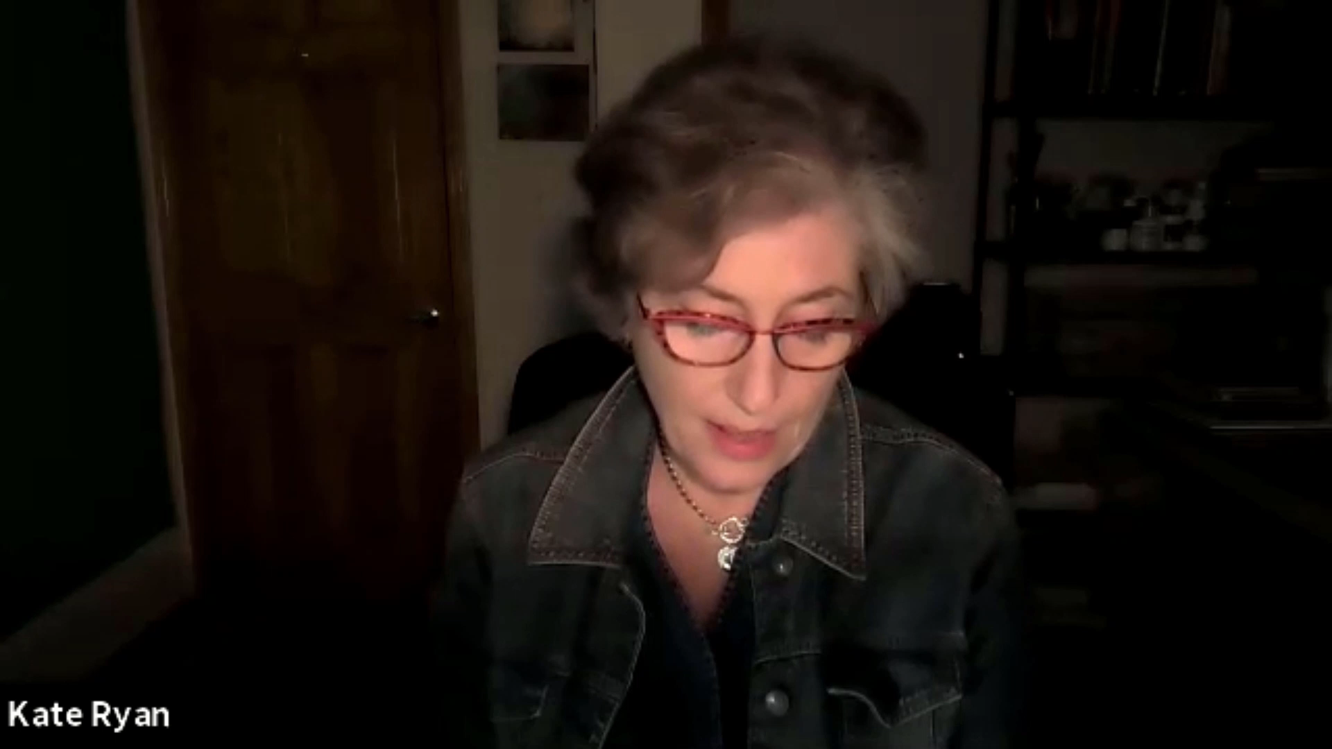

Slide 7
REVIEWS
“Ruyle's Senior Swordplay is so private and intimate that you can't help but feel like a voyeur reading it. The characters are raw, vulnerable and fully exposed, both emotionally and physically. Exceptional dialogue and expert storytelling, filled with unique and surprising moments and culminating in a powerful ending brimming with emotion and a hint of hope.”
Craig Houk
Award-Winning Playwright
Well-crafted realistic characters, superbly written dialogue, tasty conflict and a hopeful finish - what more could you want in a play? Nothing, I say! Ruyle taps into human experience like an expert, and the result is a gift to any audience. Produce!
Vivian Lermond
Award-Winning Playwright

Slide 8
Development GOALS

